Slide 1
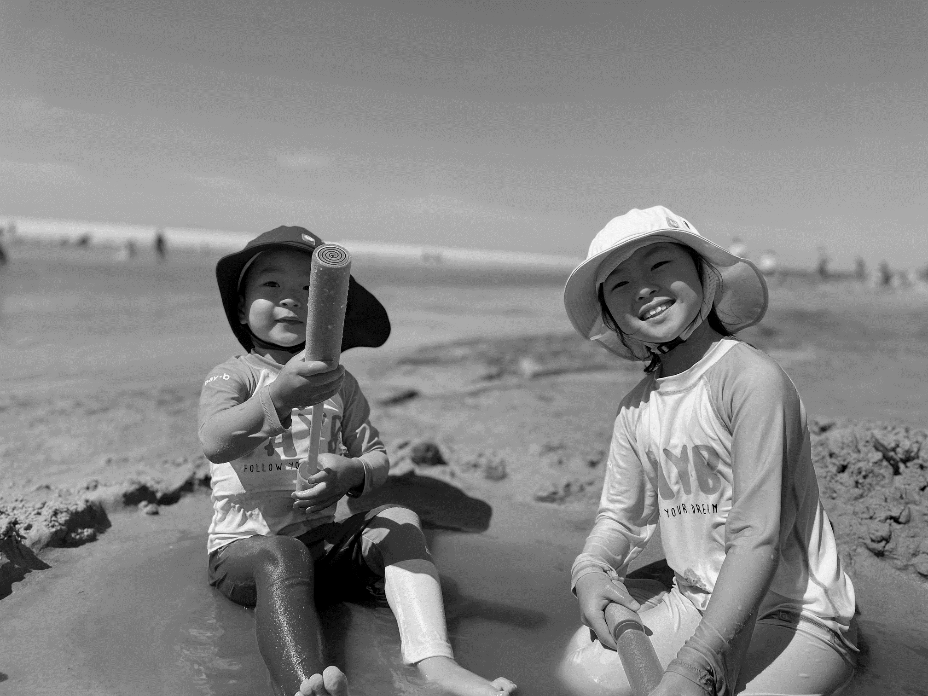
The Entrance
2A - Dana Lim

Slide 2
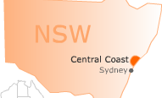
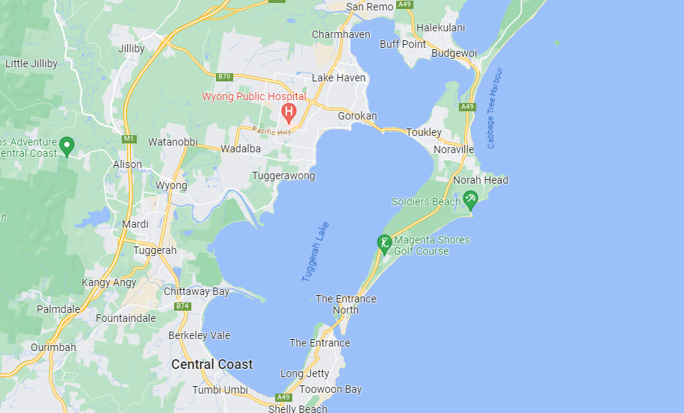
Where The Entrance is :
Central Coast
Where the Ocean and Lake meet
1 hour by car
HERE!
Tuggerah
Lake
Pacific
Ocean

Slide 3
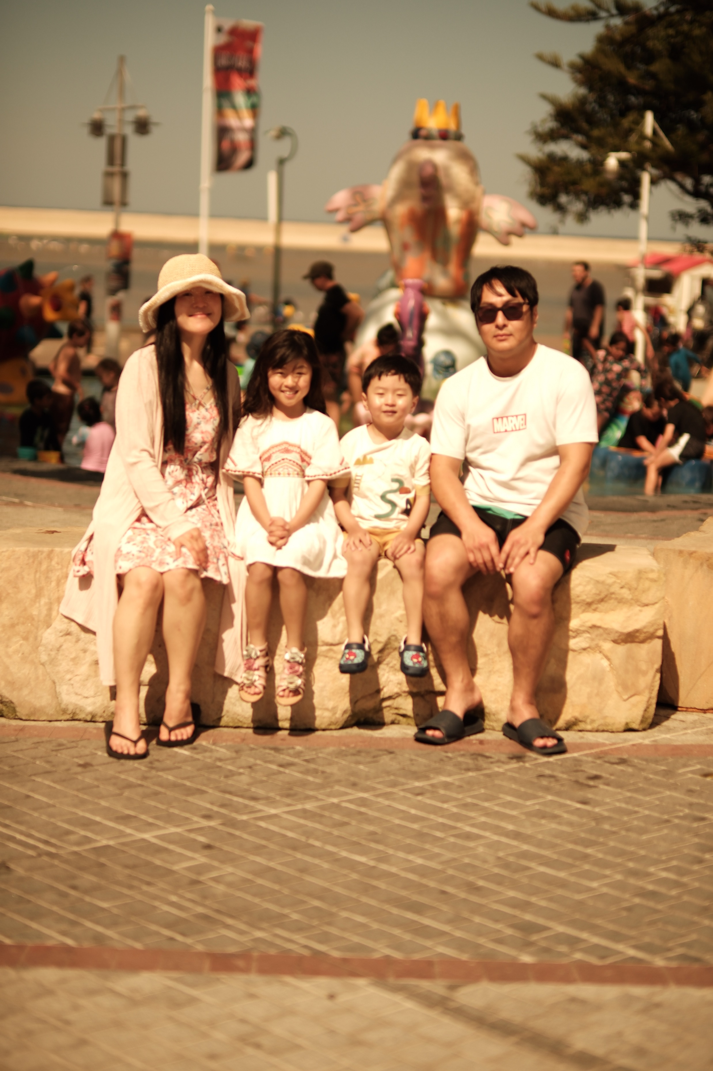
Who I go with :
My family
With others
like uncles and aunties

Slide 4
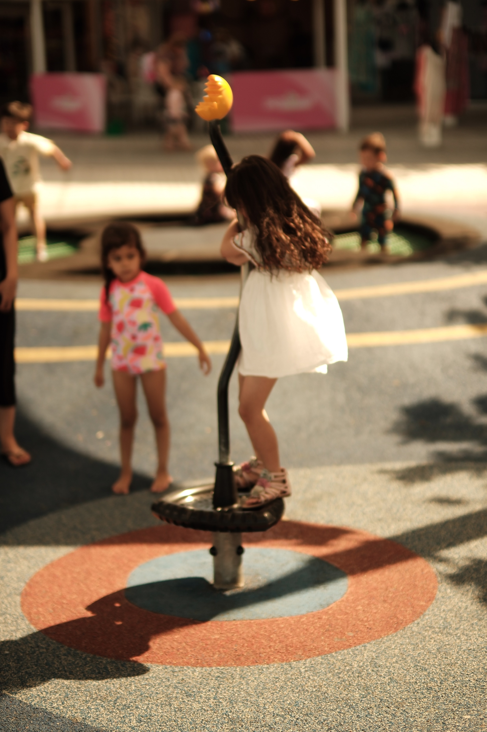
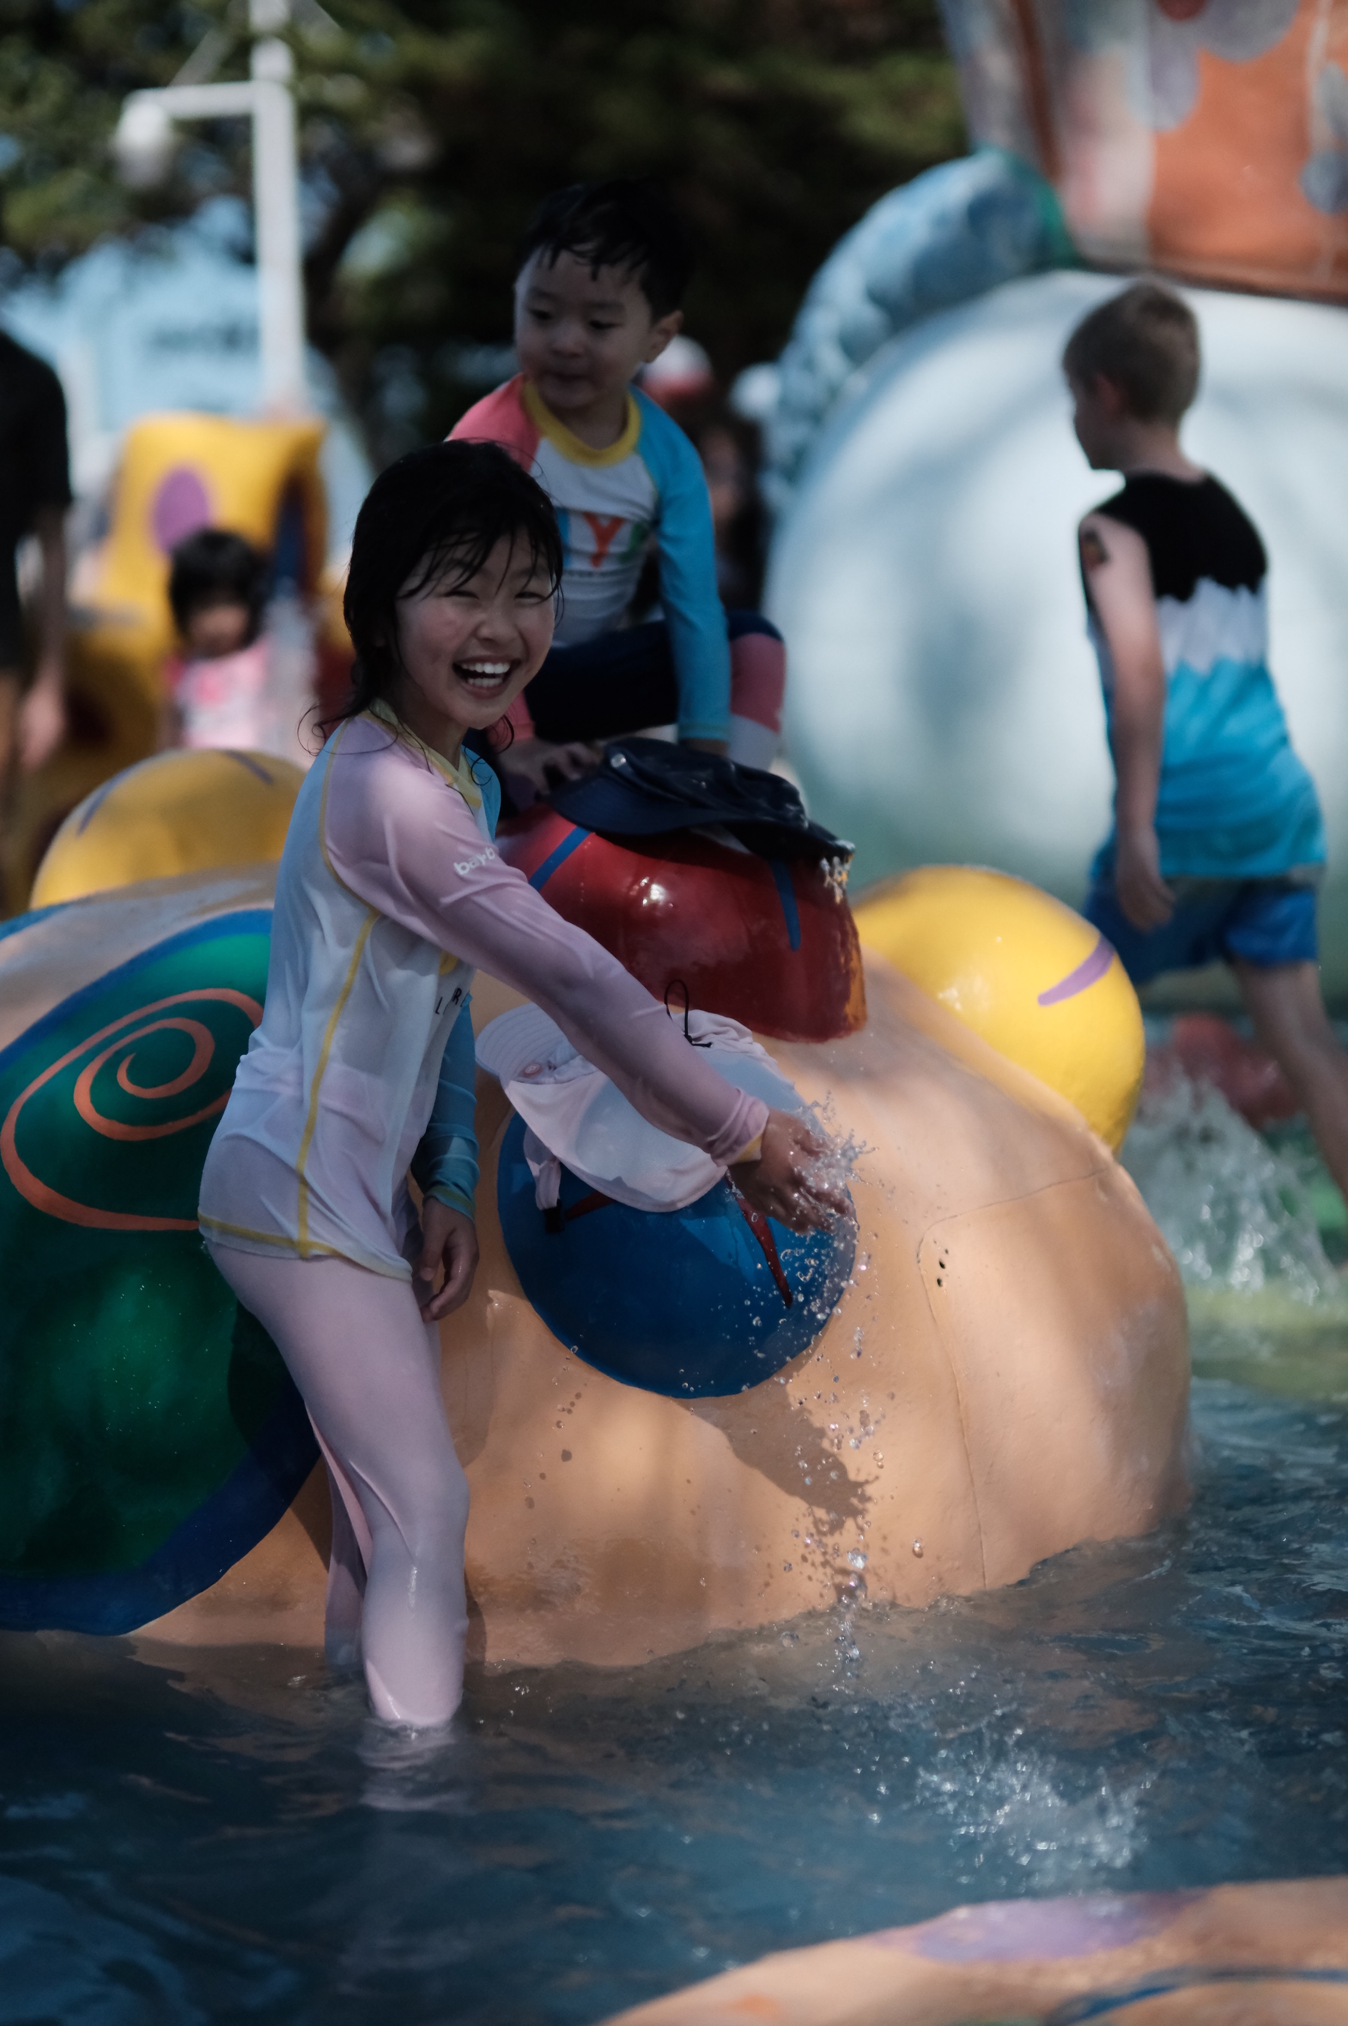
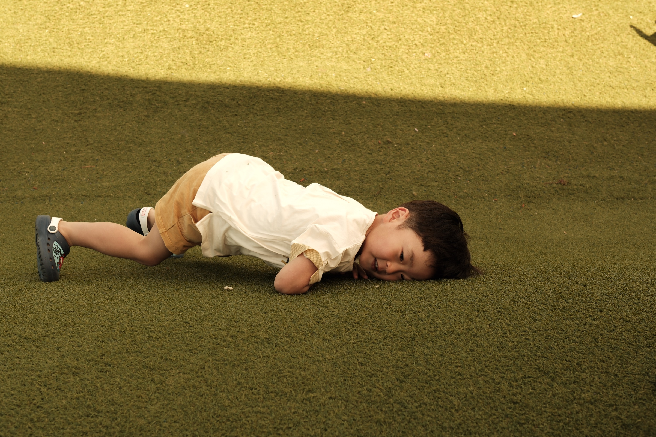
Why I like it?
You can :
Walk to little island and collect shells
Play in the water because it is shallow and safe
Play in the playground and Water Play Zone
Watch the pelican show
Buy a ticket for the fun rides

Slide 5



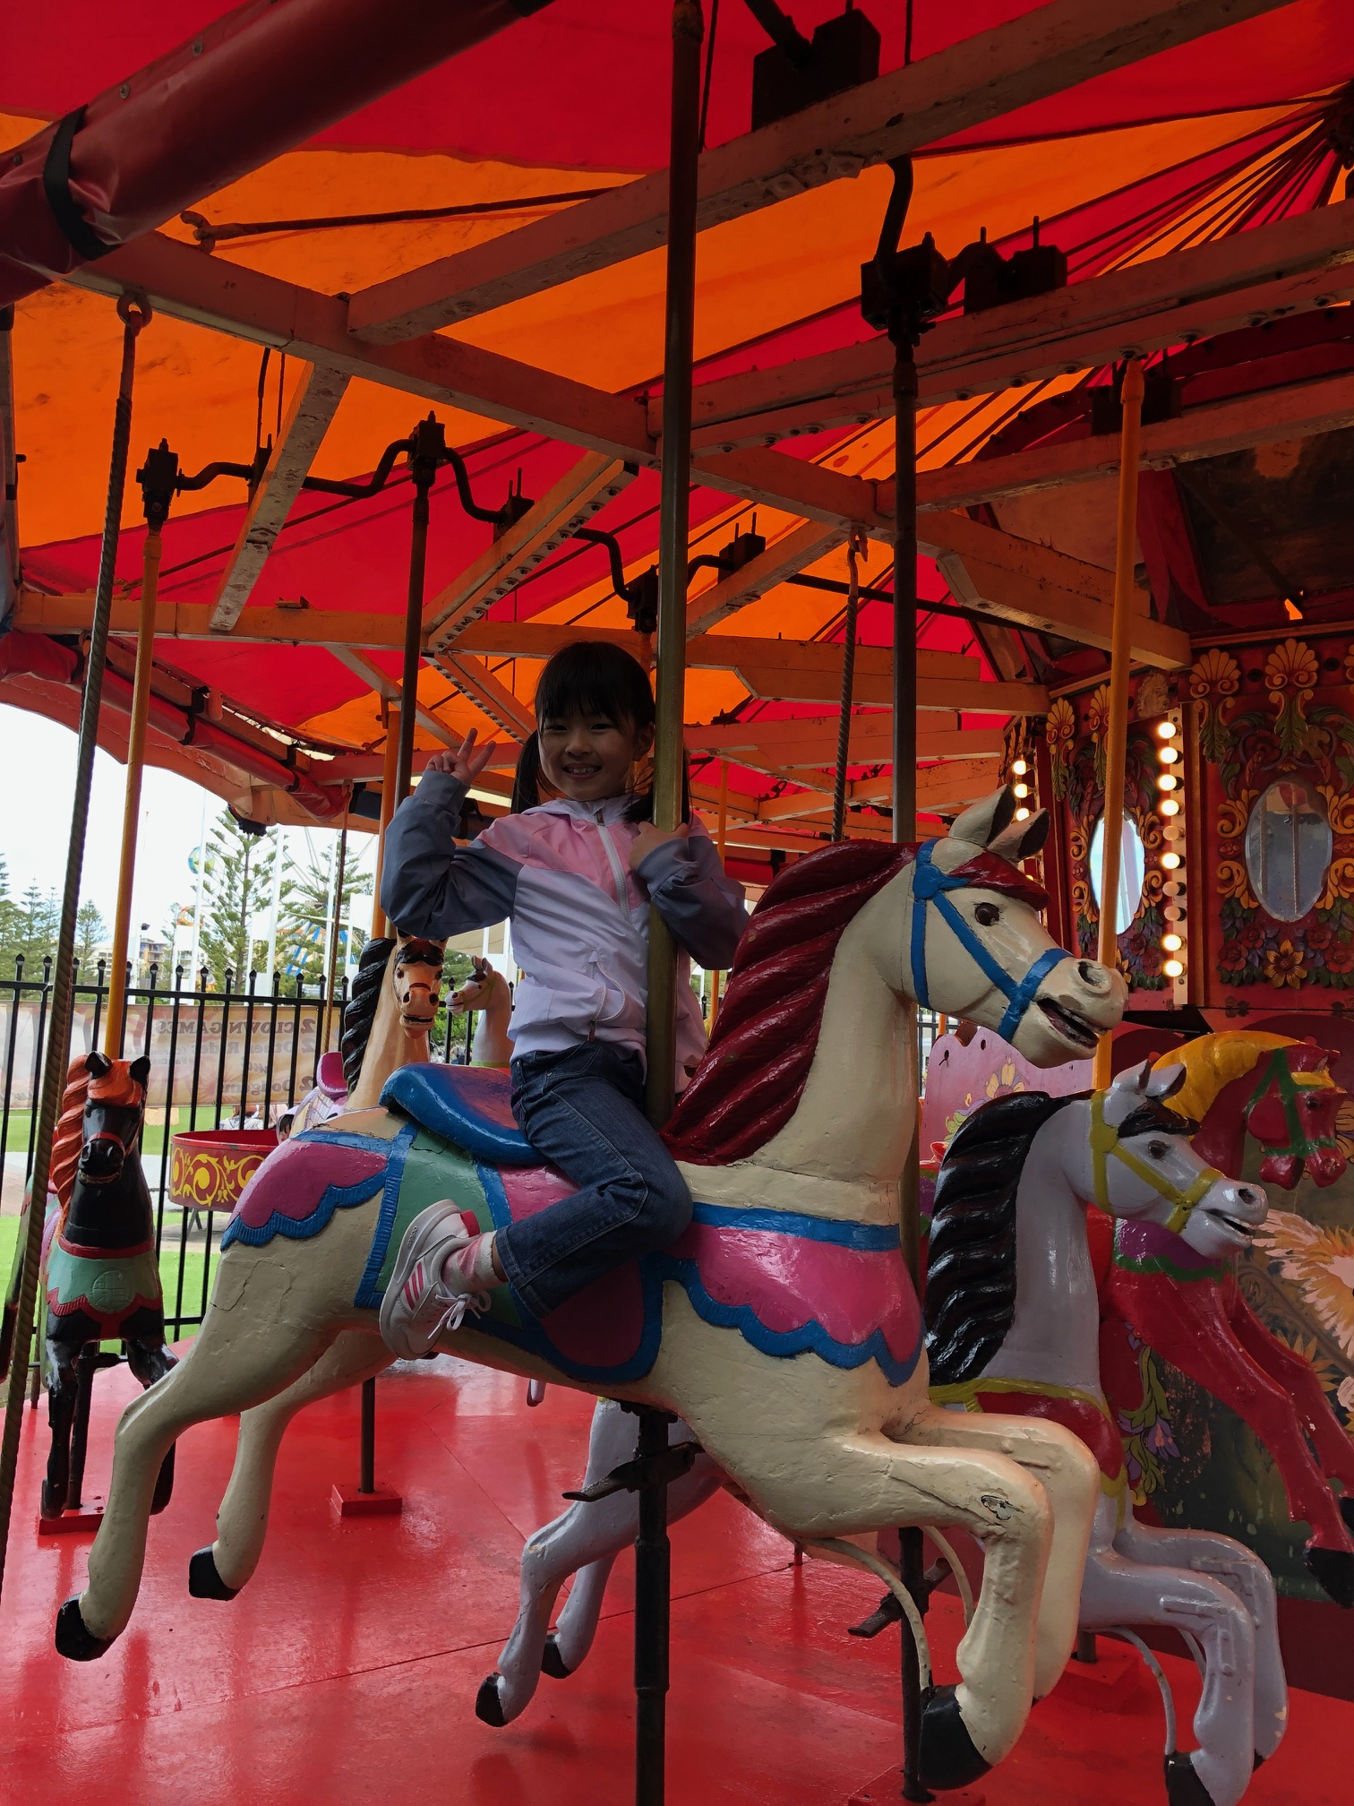
My favourites :
Merry-go-round

Slide 6

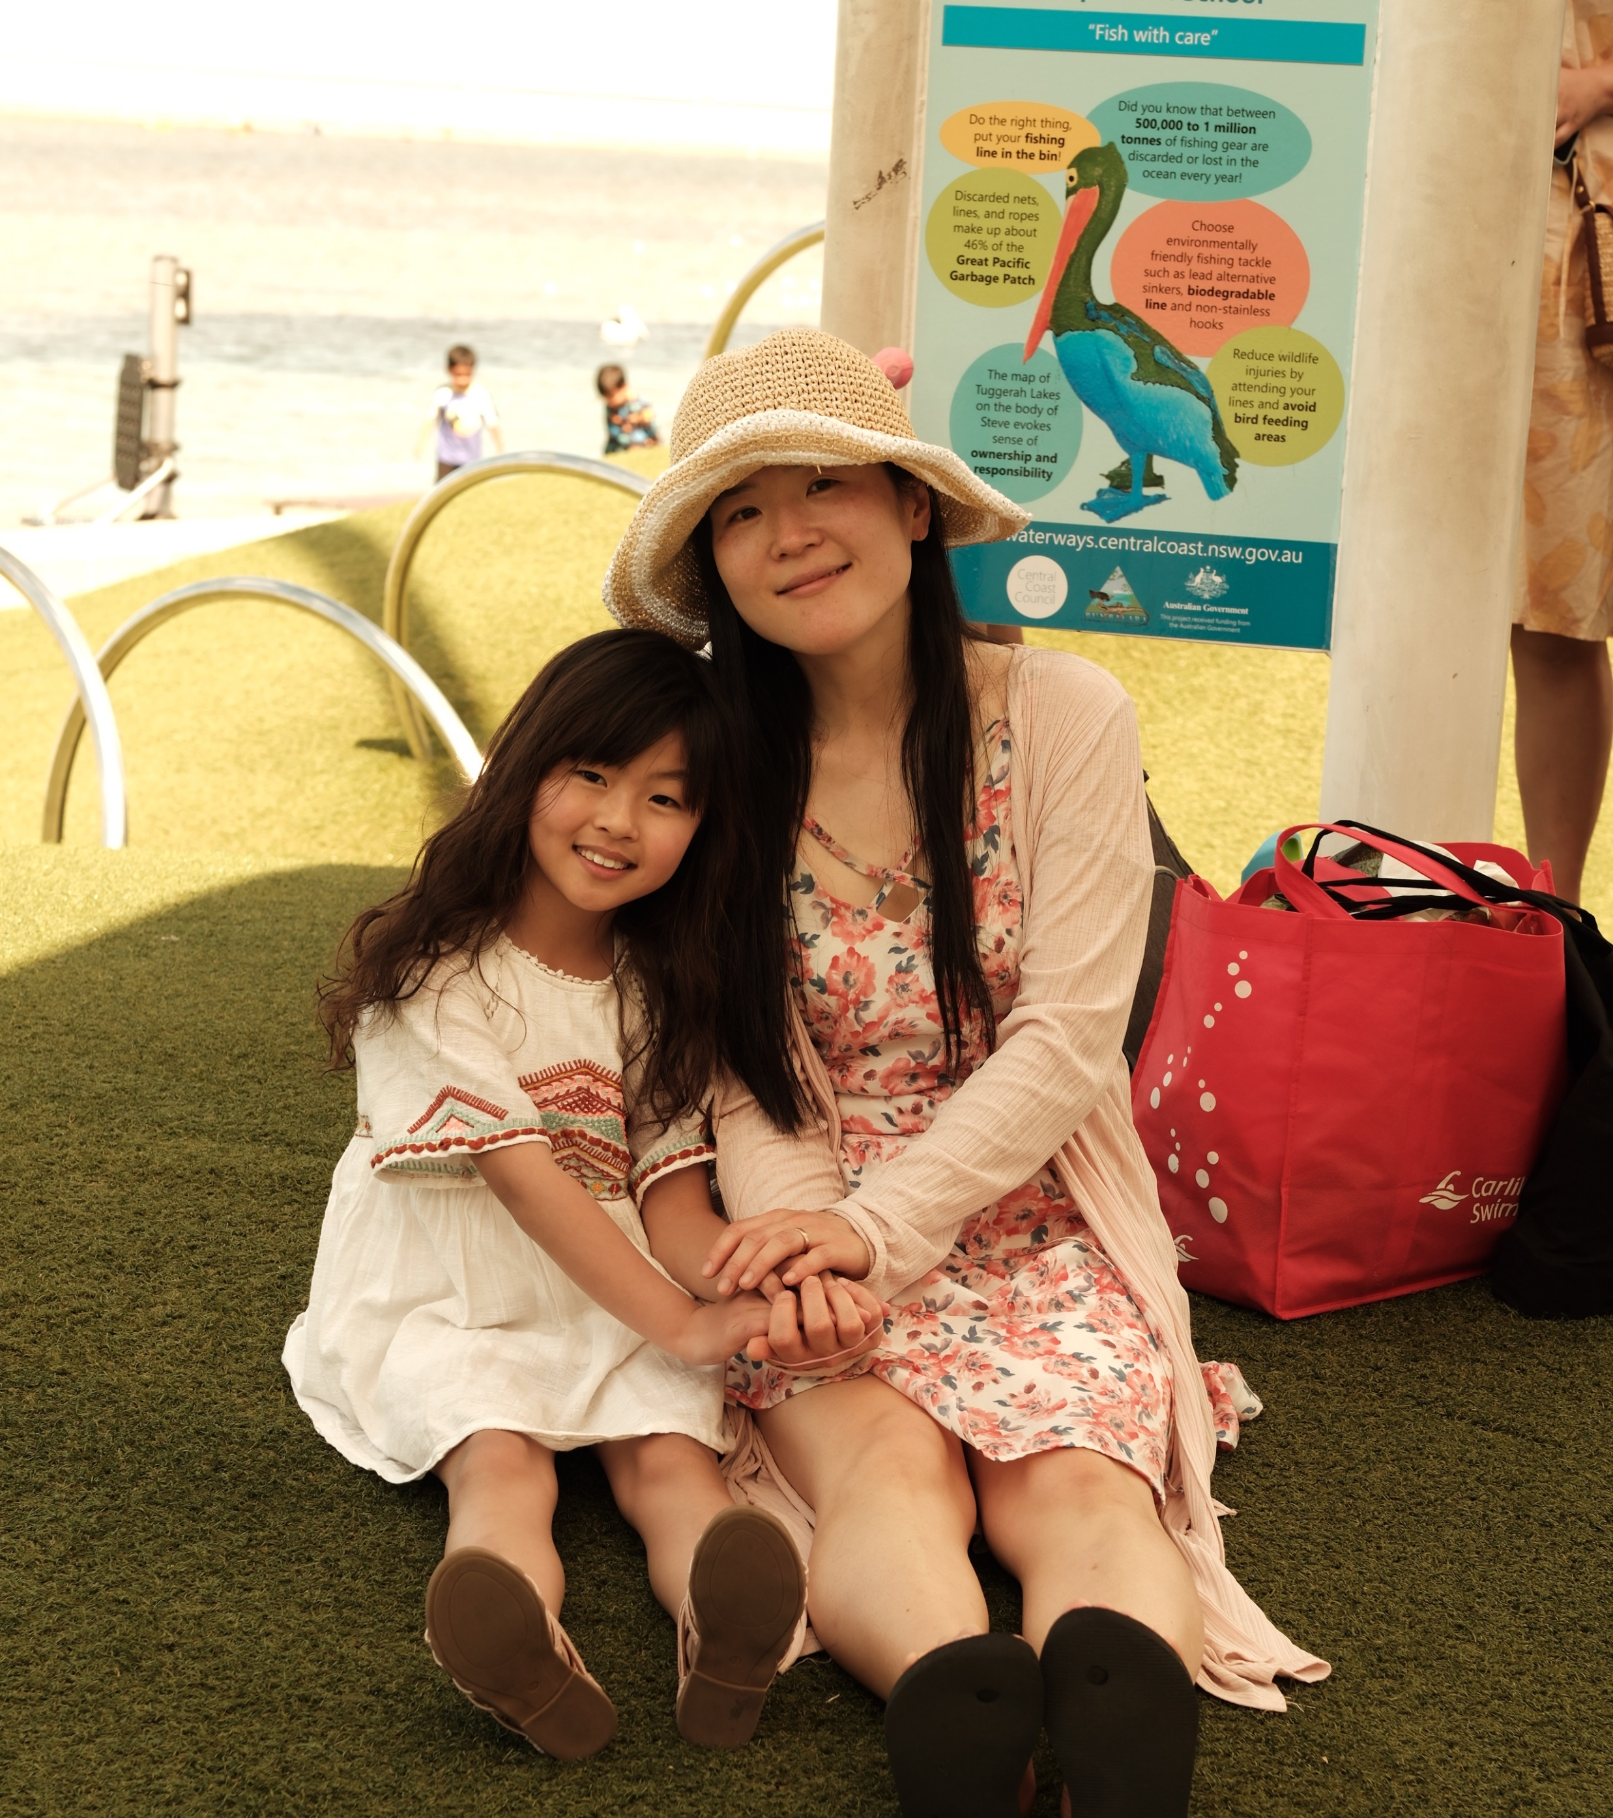
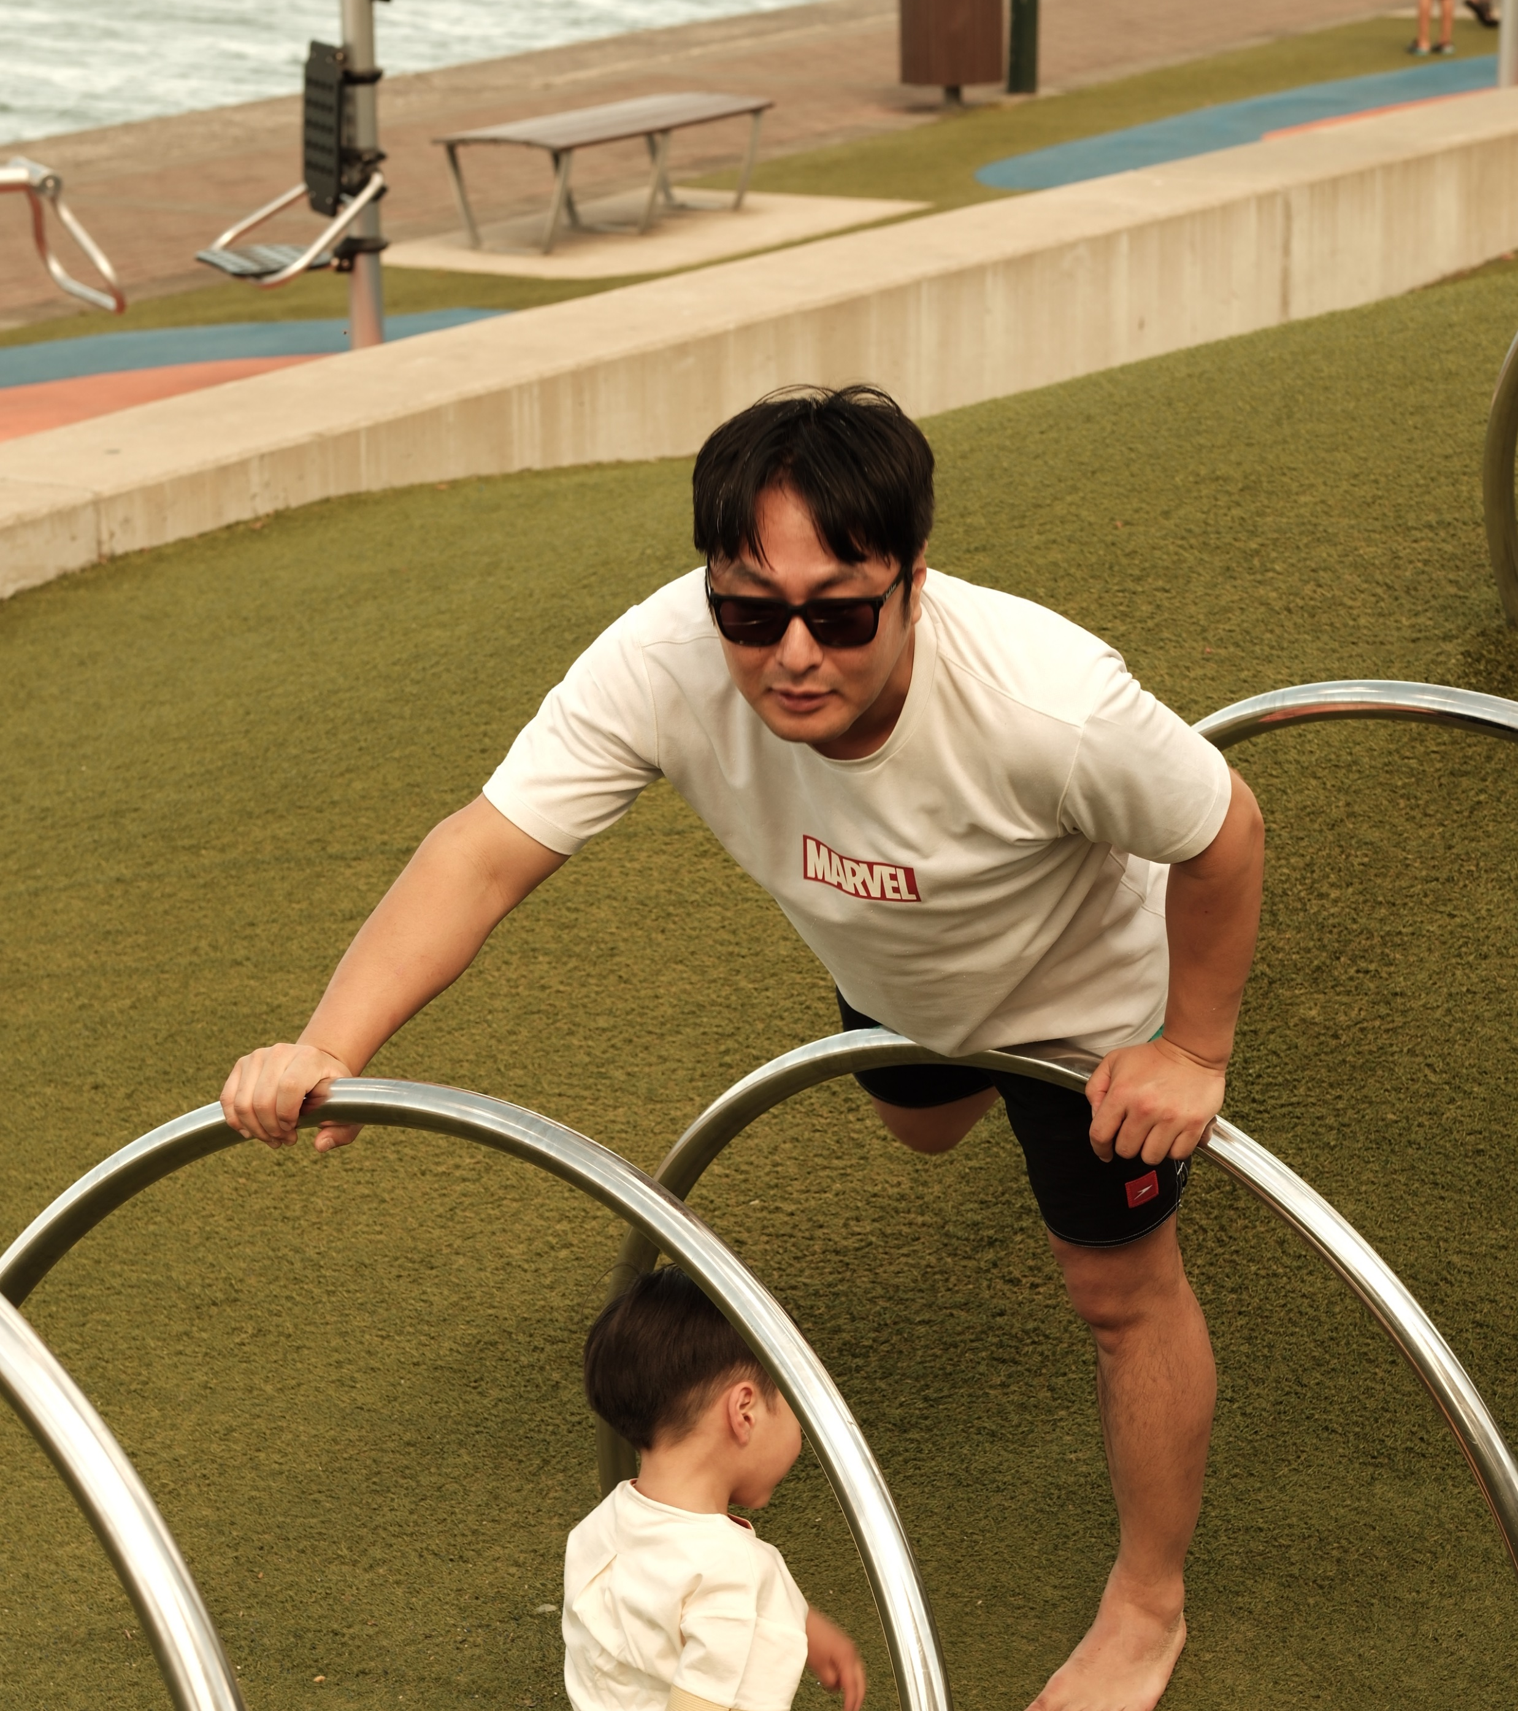
Why it is special to my family?
You can take photos at the same spot to see how much you have grown and you can see to remember the days you had.

