Slide 1
Water Safety
2A - Dana Lim
https://dana.lim.gg

Slide 2
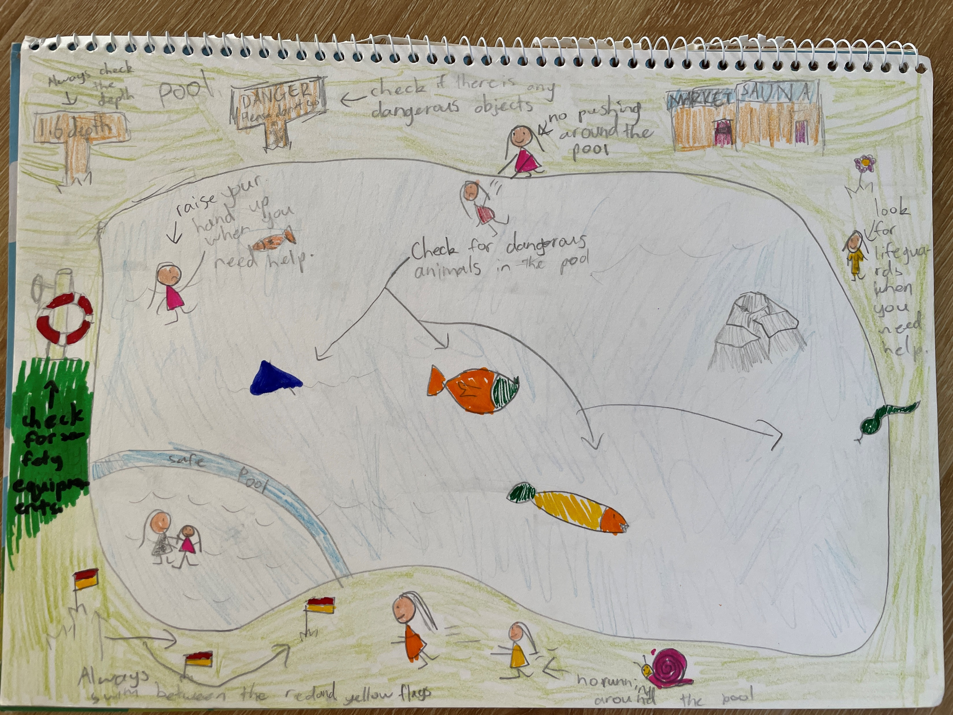

Slide 5


Slide 9


Slide 13


Slide 21
THANKS!

